Slide 1
Computer- Basics
UNF team

Slide 2
What is a computer?
A computer is an electronic device that manipulates information, or data. It has the ability to store, retrieve, and process data. You probably already know that you can use a computer to type documents, send email, play games, and browse the Web. You can also use it to edit or create spreadsheets, presentations, and even videos.

Slide 3
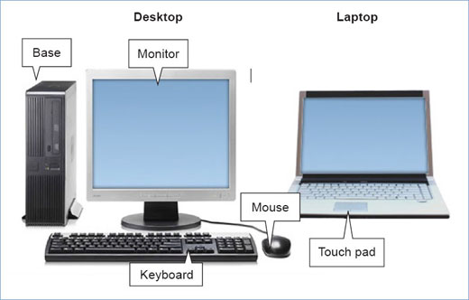

Slide 4
Hardware vs. software
Before we talk about different types of computers, let's talk about two things all computers have in common: hardware and software.
Hardware is any part of your computer that has a physical structure, such as the keyboard or mouse.
Software is any set of instructions that tells the hardware what to do. It is what guides the hardware and tells it how to accomplish each task. Some examples of software include web browsers, games, and word processors.

Slide 5
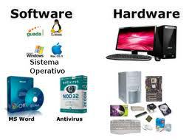

Slide 6
What is Windows?
Windows is an operating system designed by Microsoft. The operating system is what allows you to use a computer. Windows comes preloaded on most new personal computers (PCs), which helps to make it the most popular operating system in the world.
Windows makes it possible to complete all kinds of everyday tasks on your computer—for example, you can use Windows to browse the Internet, check your email, edit digital photos, listen to music, play games, and do much more.

Slide 7
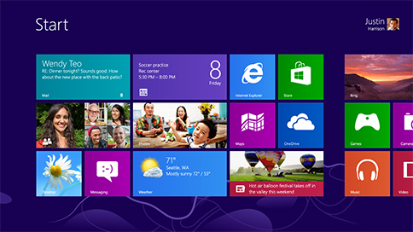

Slide 8
The mouse
Mouse gives you control over your computer. With the mouse in your hand you cause the onscreen arrow to move around your computer display. It is based on the “point and click” philosophy. You move your mouse to a point where you want something to happen, then you click to make that event take place. Sometimes you click once. Sometimes you click twice. And sometimes you hold down the mouse while your event is happening.

Slide 9


Slide 10
Keyboard
the keyboard also means learning the special functions of certain keys. On the computer keyboard you often use two or more keys at the same time, indicated by the "+" sign. For example in managing applications you wil learn that "Ctrl + Alt + Delete" is a decision of last resort. You depress these three keys simultaneously when you just want to get out of whatever muddle that the computer has left you with.

Slide 11



Slide 12
Find saved files
To begin single click on the "start" button. When that menu comes up, single-click on the Search (mangnifying glass) icon. This will bring you to the Search Companion, a Microsoft help menu designed to refine your search to produce quicker results.
Type your file name and click on search.
It will find the file for you and display it.

Slide 13
Copy and paste text
Simply highlight the text you want to copy, then select Copy from the context sensitive menu. Alternatively, you can go to Edit > Copy or hit Ctrl + C on your keyboard.
Right click on the document where you want to paste the text and select paste from the options.
Or press Ctrl and V keys on the keyboard simultaneously.
The process for pasting text is the same. In both cases you can also go to Edit > Paste to paste either text of a photograph into your document

